Slide 1
SENTIMENT ANALYSIS OF CRYPTOCURRENCY DATA
TEAM MEMBERS:
MALLIKA TRAKANPASAKUL
NANDINI PODDAR
KARTIKEYA SHARMA

Slide 2
OBJECTIVE
Our primary objective is to analyze the sentiment behind the cryptocurrency Bitcoin from 11/4/2018 to 11/11/2018 and finding a correlation between the public sentiment and market prices of bitcoin within the same time range.

Slide 3
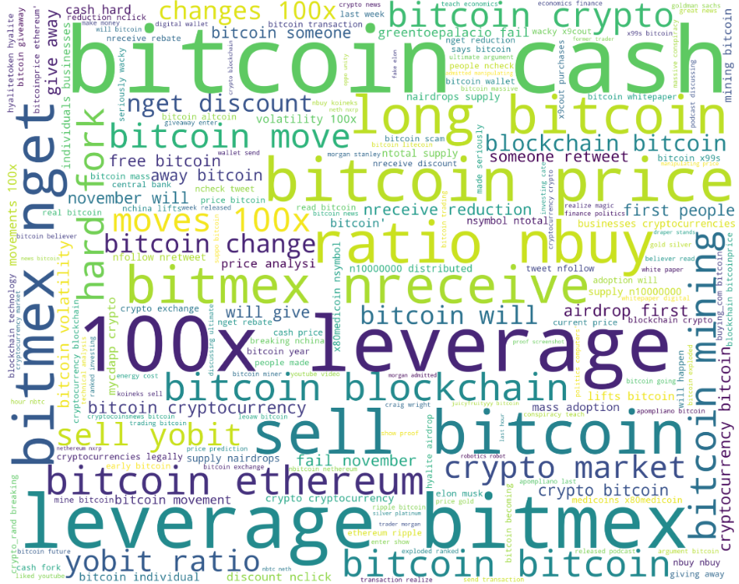
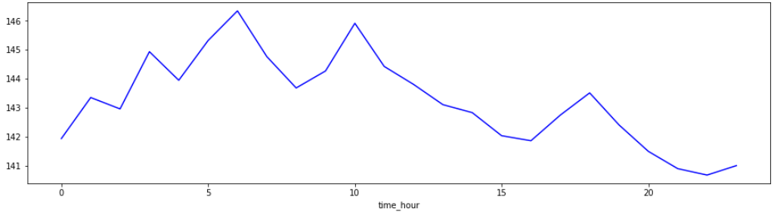
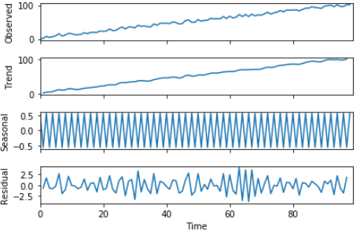
PROCEDURE
Downloaded data from Twitter API
Tweepy Package
Data Downloaded for #bitcoin
Performed data cleaning
Tokenization
Removal of Special Characters
Text sentiment analysis
Lexicon Word Match Approach
Word Match to find tweet polarization, scored -1,0,1 based on sentiment
Time Series Analysis
to find seasonality in number of tweets

Slide 4
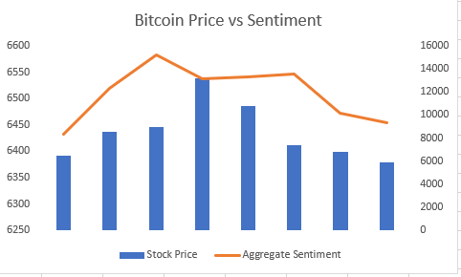

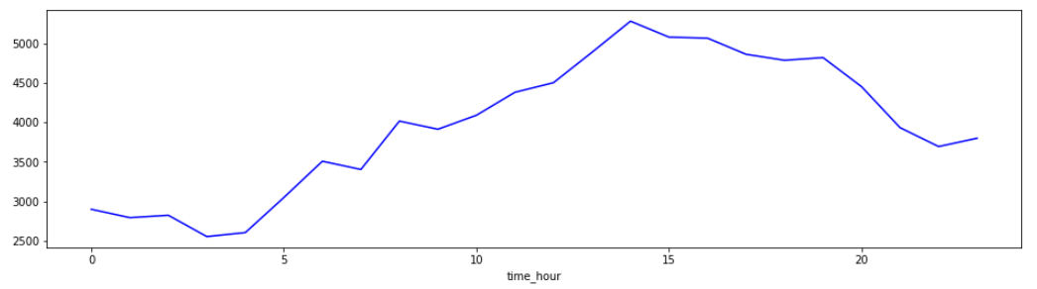
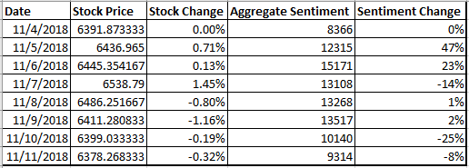
ANALYSIS & INFERENCES
Performed Time series analysis
Correlation of 62% between Bitcoin Price and Sentiment Score of Tweets
Generally Positive Sentiment (40%)
Low Sentiment positive Sentiment Initially, however as the day progresses, the sentiment is gradually more positive
However, it could be due to sheer number of tweets
Notes:
i

Slide 5
Challenges and Limitations
Parsing - What is the subject and object of the sentence, which one does the verb and/or adjective actually refer to?
Sarcasm - If you don't know the author you have no idea whether 'bad' means bad or good.
Twitter - abbreviations, lack of capitals, poor spelling, poor punctuation, poor grammar, …
Only Mined for ‘#bitcoin’, there could have been other #tags to describe Bitcoin tweets

Slide 6
THANK YOU!! :)

